Slide 1
Hand Gestures to control video call features
By: Jackie, Alvin and Maddin

Slide 2
Problem being addressed
Some users have found the shift from in-person lectures to online too difficult or challenging to use. Our prototype is designed to ease users into online learning by using hand tracking to detect common hand gestures used in person to control video call features.

Slide 3
Why is this problem relevant to address?
The Covid-19 pandemic caused a surge in the use of video calls as many in person activities have been moved to online. Some users found the shift from in person activities to virtual too difficult or distracting. This is especially true for students that have shifted to online lectures which can affect their learning and grades.

Slide 4
What has been done so far by others?
Hand tracking technology has already been created that controls functions such as pulling, pushing, or pinching.
Online video calls are already widely used by companies and schools including google meets or discord.

Slide 5
How does your solution tackle the problem?
Our prototype allows users to use common gestures to control video call functions. This allows them to easily control call functions and immerses them into the classroom. Users that have trouble with online lectures will find our solution easier to use and less distracting. It can create a more natural flow for all users as their physical actions influence the video call.

Slide 6
Takeaways
Hand gestures could make video calling more immersive and easier to control with the right implementation.
Gestures need to be distinct, clear and unable to be confused for each other or other basic human actions.

Slide 7
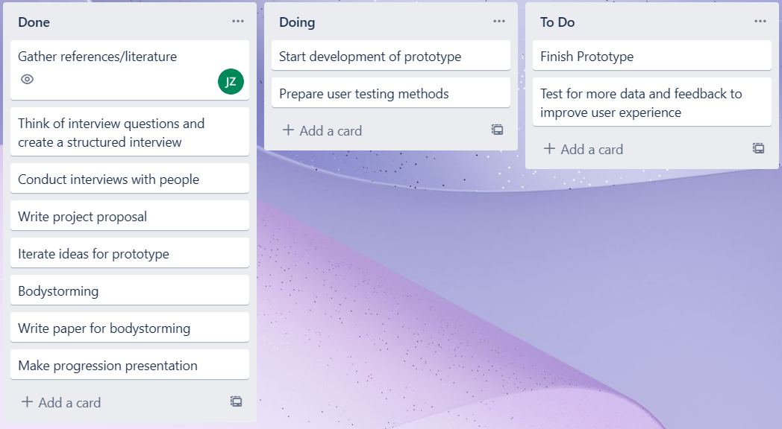
Project progression
Notes:
Jackie
Project progression in comparison to the first assignment.

Slide 8
Demo
Acknowledgement: https://techvidvan.com/tutorials/hand-gesture-recognition-tensorflow-opencv/
Notes:
Jackie

Slide 9
Next steps
UI Mockup to customize each gesture per function, allowing users to choose their own gestures.
Testing how user will feel using their non-dominant hand
Gathering a large amount of different gestures that can be inputted as options users may choose from, as well as determining which gestures feel the most natural.
Testing the accuracy of hand tracking and trying to improve it
Notes:
Jackie

Slide 10
Thanks for Listening
Notes:
Jackie

